Slide 1
Comp Photography
Final Project
Deliang Yin
Fall 2017
deliang.yin@gatech.edu
Computational Photography @ GT

Slide 2
Image Colorization
This project is to colorize the black and white images. In addition, I extended to black and white videos
Computational Photography @ GT

Slide 3
The Goal of Your Project
Original project scope:
1. Colorize still black and white images
2. Colorize black and white videos
What motivated you to do this project?
When I was a child, I saw some funny black and white movies, like the ones by Charles Spencer Chaplin. At that time, I thought that it would be wonderful if they are colored, which left me a room for imagination. After learning computational photography, I finally equipped necessary skills to fulfill my child dream.
Computational Photography @ GT

Slide 4
Scope Changes
Did you run into issues that required you to change project scope from your proposal?
I finished colorizing still black and white images. As such, I extended the scope to colorize black and white videos.

Slide 5

Showcase
Showcase what you did on This One Single Slide. That might be challenging. You may use several images and format how you wish; but this single slide should be a good pictorial representation of your work. Be creative.
Input
Output
Computational Photography @ GT

Slide 6
Project Pipeline
Input BW image and marked images in RGB
Convert from RGB to YUV format
Find the marked area
Calcualte weights in a neighbor
Find matrix A and vector b
Solve Ax=b
Manual
Automatic
Convert from YUV to RGB
To colorize still images
Show your major functions and algorithms.
Explain your steps for the project as you actually completed it.
Indicate which steps are part of your automatic pipeline, and which are manual.
Output
Computational Photography @ GT

Slide 7
Demonstration: Result Sets
Demonstrate at least three complete result sets. If your results can easily be shown here in your slides, please do. Explain in detail what you are showing.
These may be incorporated into the Project Development section, but make sure they are complete.
Provide links to videos or gifs, and large or numerous image sets.
Computational Photography @ GT

Slide 8
Demonstration: Result Sets (cont’d)
Use as many pages as necessary
Computational Photography @ GT

Slide 9
Project Development
Use several slides for a detailed discussion of how you developed your project outputs. Tell your story. Difficulties with developing your code may also be discussed here, or in the following Computation section.
Include:
Narrative of your progress and issues you faced.
Include descriptions of problems, and how you handled them.
Include both good and failed interim results (from various parts of your work and pipeline)
Include a high level of details.
What would you do differently?

Slide 10
Project Development – Image Colorization
Purpose: to colorize still black and white image
Step 1: Take a colored image, and convert it to black-and-white
Convert the colored image into YUV format
Keep only intensity channel Y, and ignore the color channels U and V
Convert the Y channel back to RGB channel
Save to black-and-white image
Note: see function for coding details

Slide 11
Project Development – Image Colorization
Step 2: Manually mark the black-and-white image using color scribbles
I used Photoshop to mark the black-and-white image. I chose the following two coloring methods
Constrained to keep their original colors
Free to choose other colors for comparison

Slide 12

Project Development – Image Colorization
Step 3: To convert the black and white images from $RGB$ format to $YUV$ format, where $Y$ stands for intensities, and $U$ and $V$ contain relevant color information.
$$Y = 0.299×R + 0.587×G + 0.114×B$$
$$U = −0.147×R − 0.289×G + 0.436×B$$
$$V = 0.615×R − 0.515×G − 0.100×B$$
Note: the coefficients above are based on paper by Jack 2001 (see Source slide)

Slide 13
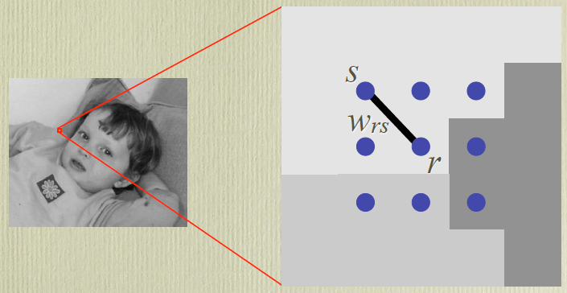

Project Development – Image Colorization
Step 4: To find the matrix U such that J(U) is minimized:
$$J(U)=\sum_{∀r∈Image}{{\left(U\left(r\right)− \sum_{s∈N\left(r\right)}{ω_{rs}×U\left(s\right)} \right)}^{2}}$$
Subject to constraints: $U\left[r_{m}\right]=u_{m}$, where $r_{m}=\left[i_{m},j_{m}\right]$ are all marked pixels and $u_{m}$ are pre-specified marked colors.

Slide 14
Project Development (cont’d)
Use as many pages as necessary.

Slide 15
Computation: Code Functional Description
Walk through your code functions
Show and discuss code snippets. Explain the purpose of the code you’re presenting.
Explain the major algorithms. If you used them, show that you understand them in your own words. Do not copy from your technical paper.
Include descriptions of libraries/packages that you used
Code discussion may be incorporated in the Project Development section if that works better for you.
Make sure you credit your sources explicitly, either here or in Resources. Failure to credit code sources may result in zero score for project.
Use as many pages as necessary.

Slide 16
Computation: Code Functional Description
Use as many pages as necessary.

Slide 17
Resources
Source paper
Anat Levein, Dani Lischinski, Yair Weiss, Colorization using Optimization
Source matlab code
Conversion from RGB to YUV and YUV to RGB
Jack, K. 2001, Video Demystified, 3rd edition ed. Elsevier Science & Technology
Computational Photography @ GT

Slide 18
Appendix: Your Code
Submit your code in a folder in the resources.zip folder. Your code will be inspected, and may be run.
Code Language: Python, Matlab, Java, etc.
List of code files:
ReadMe.txt
Colorize_Img.py
Colorize_Video.py

Slide 19
Credits or Thanks
Online converter from video to frames
RGB to YUV conversion formula
Computational Photography @ GT

